Slide 1
HealthifyMeal
Final Project II
Prepared by:
Emmad (021-18-43302) Shahbaz (021-18-43208)
Supervisor:
Dr. Asim Rizvi

Slide 2

Outline
Introduction.
Problem summary.
State Of the art.
- History.
- What is being done now ?
-Sponsor
Proposed Solution.
- Mission statement.
- Scope.
- Objectives.
- Benefits.
- Outcomes.
- Features.
-Implementation issues and
challenges.
Use Case/Primary Audience.
Target Market
Platform / Technologies
Why our project is unique ?
Division of Work
Conclusion.

Slide 3
Introduction
What is HealthifyMeal?
One Stop Solution
Personalized Meal Plans
AI & ML-based Recommendation System
Order the Suggested Meal
1:1 Virtual Consultation

Slide 4
Problem Summary
Our Society’s Current Eating Habits
Lack of Meal Planning
Foreign Applications Practicality
Health Blogs follow “One Size Fits All”

Slide 5
Proposed Solution
Mission Statement:
To promote healthy meal education and build a habit of meal planning in people.
Scope of the Project:
The project scope involves generating meal recommendations, ordering the same meal, and offering 1:1 virtual dietician consultation.

Slide 6
Proposed Solution
Objectives:
To create an automated meal planner application to promote healthy meals and lifestyle using Artificial Intelligence.
To develop the best available meal plans with the available literature and dieticians.
To monetize the platform and onboard users to take advantage of our learning and order meals with the convenience of the mobile application.
Benefits
HealthifyMeal turn healthy meal planning into an effortless and magical experience.
You can customize and control your diet; whether you are vegetarian or non-vegetarian or looking to gain or lose weight, we have you covered.
It helps save time and take the anxiety out of picking what to eat and how to prepare your meal — also, no more wasting time in searching and viewing cooking tutorials.

Slide 7
Proposed Solution
Outcomes/Final Product
A full-fledged user-friendly mobile application.
Vast database accompanying all the meal plans based on different users’ needs.
Commercial kitchen to be set up to monetize the business.

Slide 8
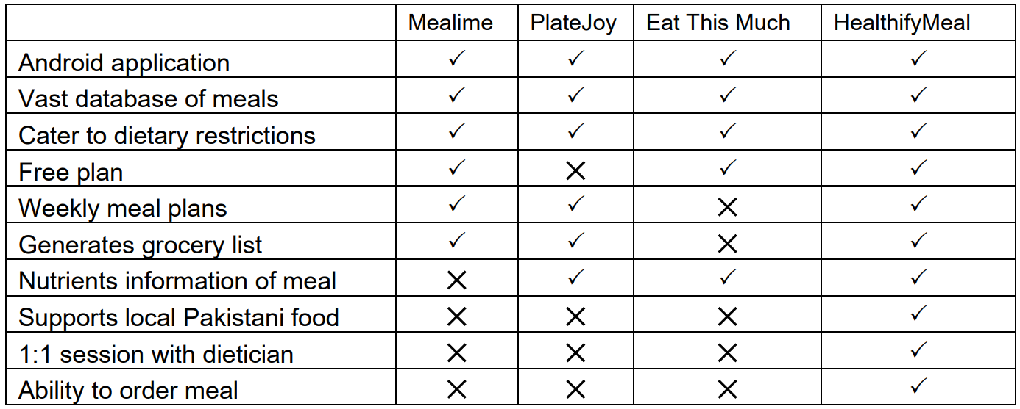
Proposed Solution
Features:

Slide 9
Proposed Solution
Implementations issues and challenges:
The food space is highly dominated by giants like Foodpanda and Cheetay.
To build a vast database of meal plans accommodating all sorts of users and needs.
Achieving the highest level of accuracy and keeping the cost low.

Slide 10
Use Case/Primary Audience:
User
Dietician
Admin

Slide 11
Target Market
The target audience is any individual, a gym with a huge population of health-conscious people, and corporate organizations concerned about their employees' health.

Slide 12
Platform/Technologies
HealthifyMeal application will be an android application.
It will be an AI and ML-powered application to generate meal recommendations.

Slide 13
Why is Our Project Unique?
Personalized meal plan for every individual considering their dietary restrictions and preferences.
Order healthy meals right from the application.
Expert consultations available on-demand.

Slide 14
Division of Work
System Implementation. (Emmad)
Database design. (Shahbaz)

Slide 15
Conclusion
The success of recommendation systems relies on the algorithm it uses to generate predictions.
HealthifyMeal goal is to offer maximum accuracy by implementing the best approach to generate recommendations.

Slide 16
Thank You
For Your Attention !

